Slide 1
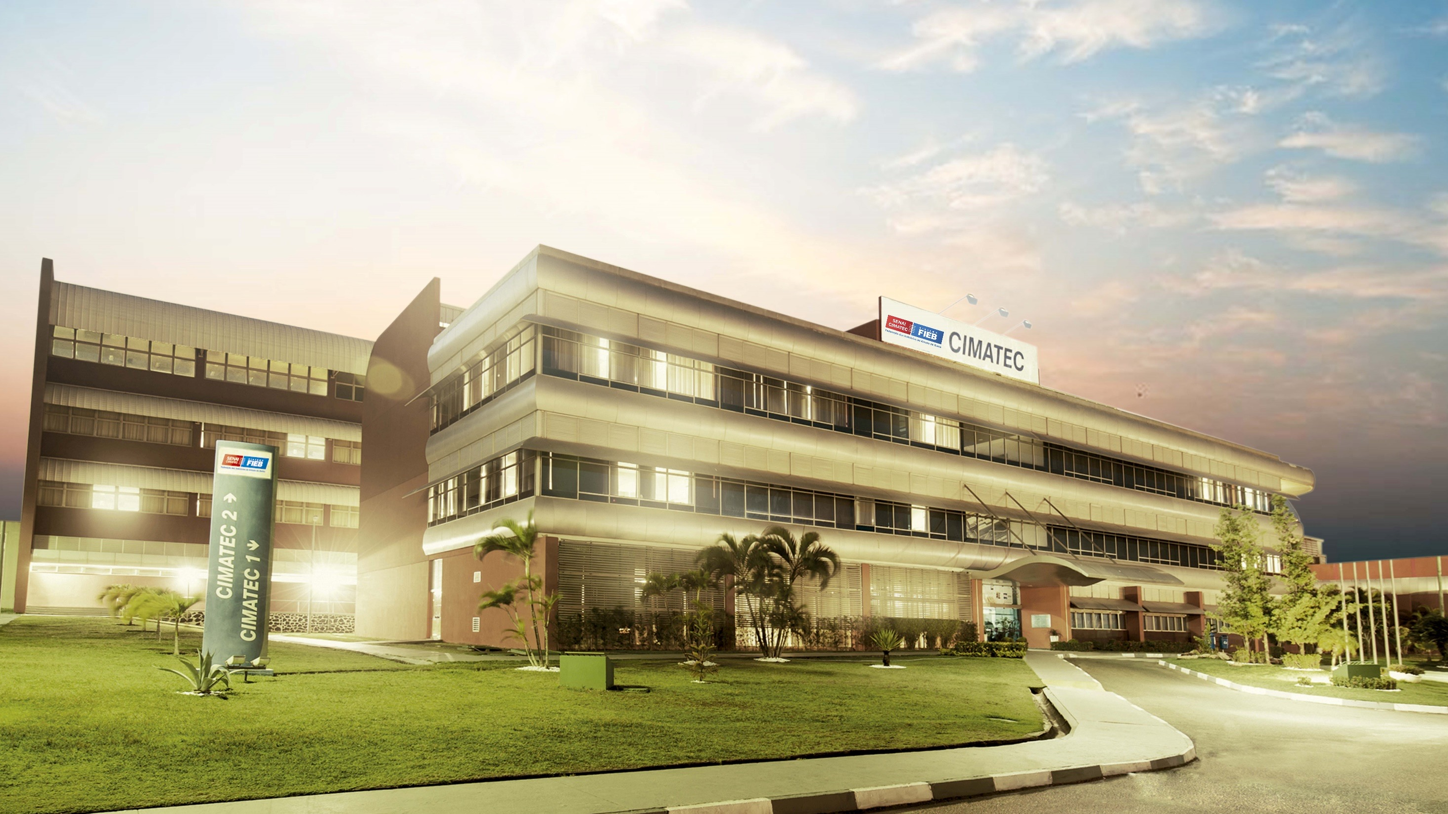






Slide 2

SENAI
CIMATEC

Slide 3

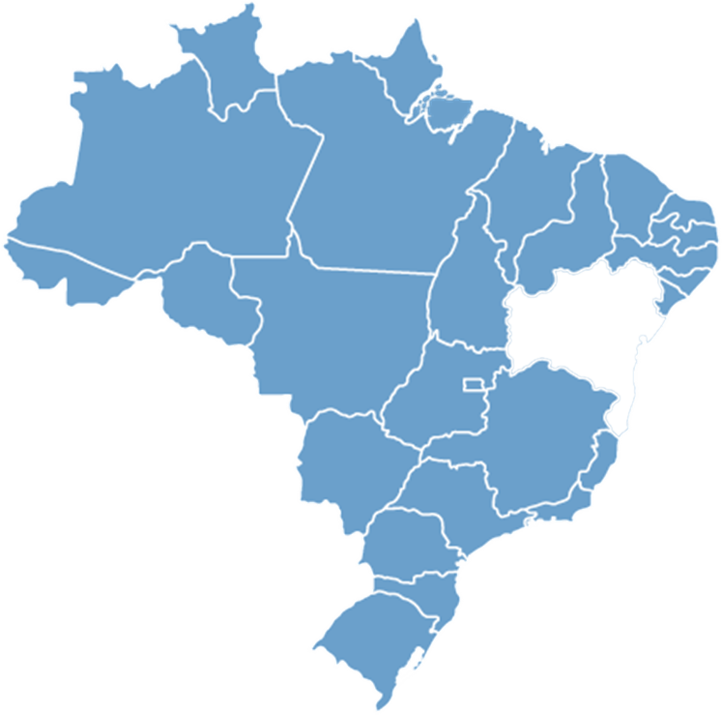
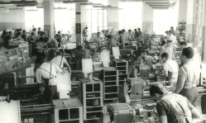





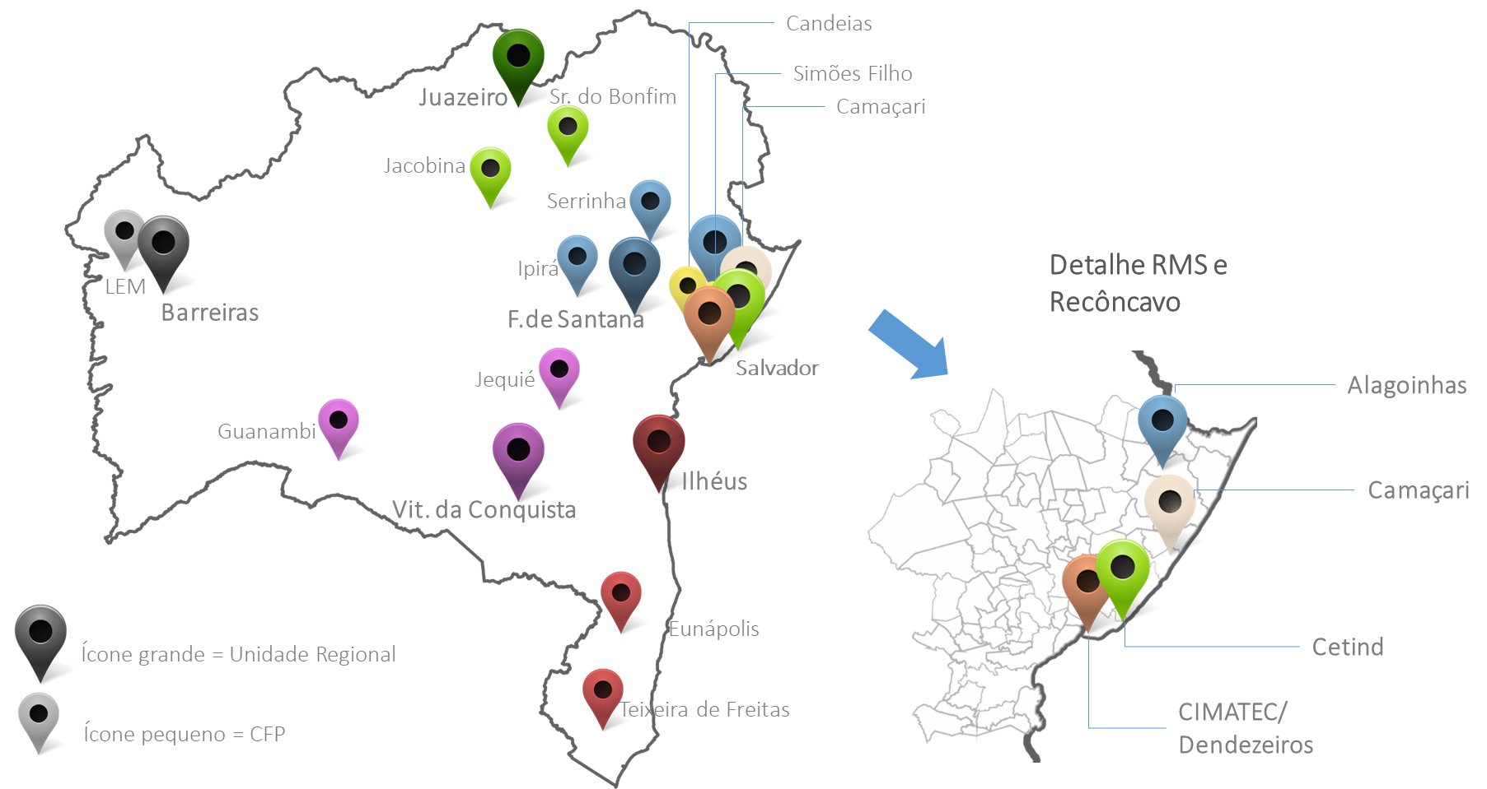
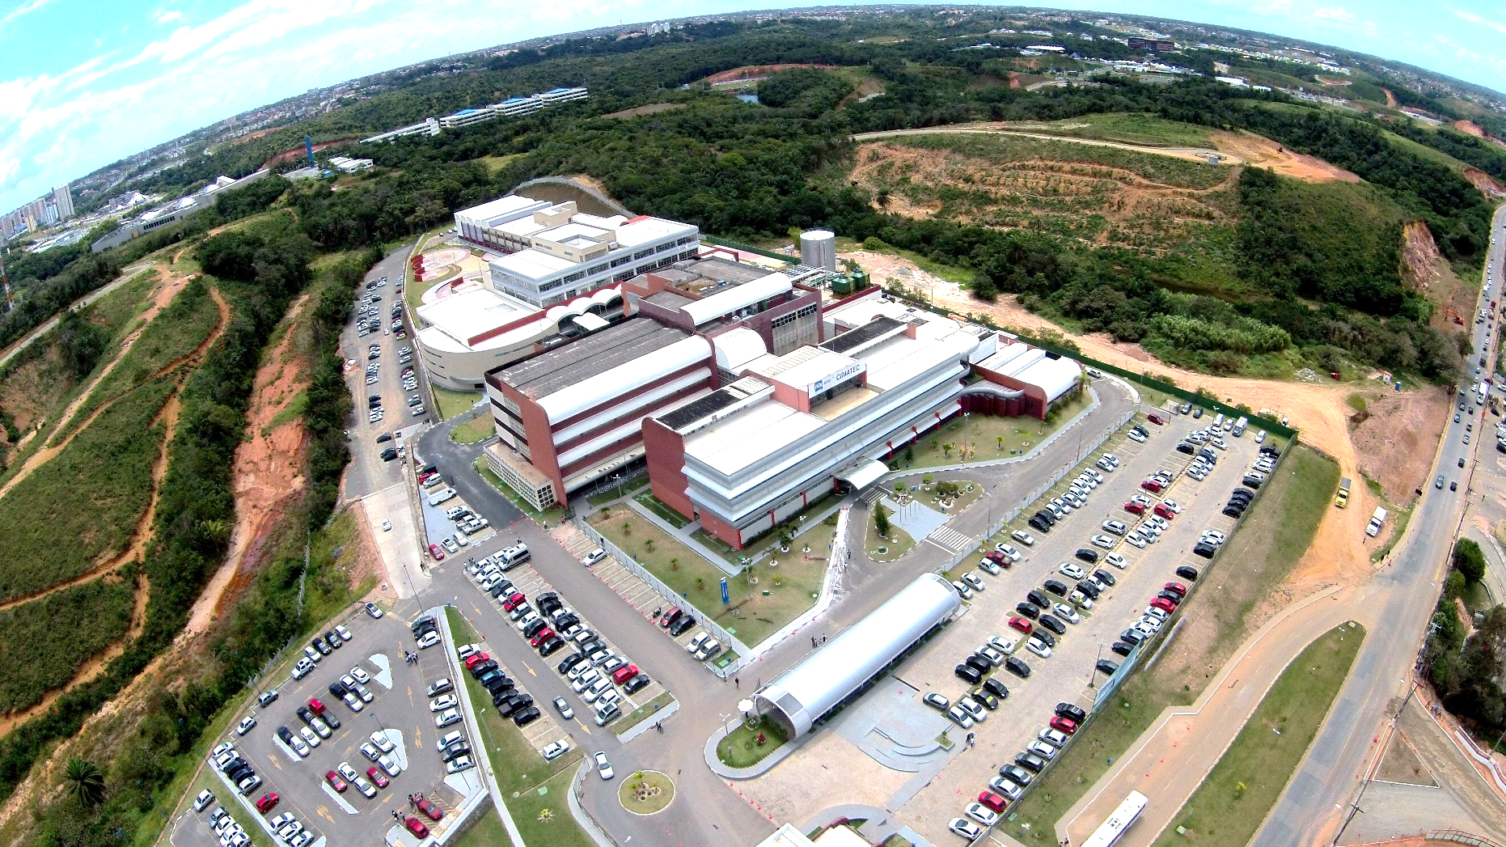
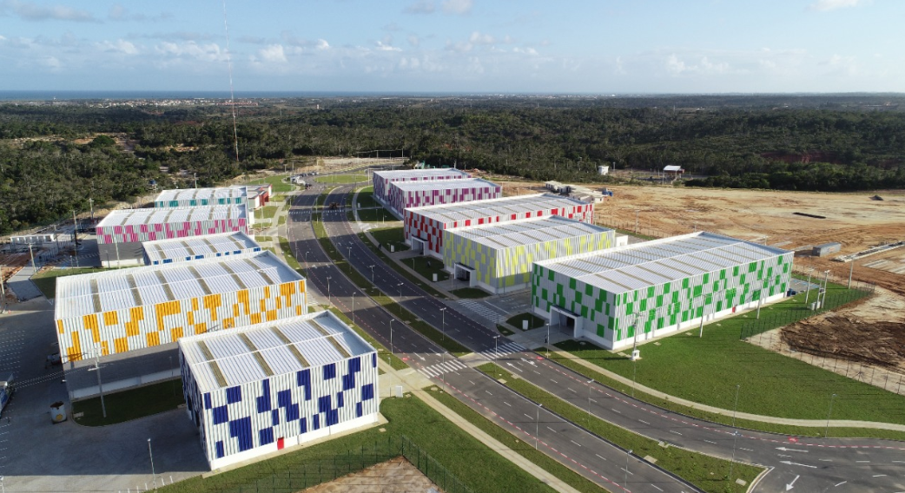





SENAI & CIMATEC Overview
National Service of
Industrial Training (SENAI)
Private and Non-profit
Created by decree of law in 1942
Mission: provide the Manpower
training to Brazilian Industry
SENAI is present in all 27 states in Brazil
Represent all the sectors of the Brazilian
industry
Over the years the
industry needs change
focusing in increasing
sustainability and new
ways of innovation.
Located at Bahia State
Manufacturing and Technology Integrated Center
SENAI CIMATEC created in 2002
CIMATEC Park created in 2019
CIMATEC
CIMATEC PARK
4 Buildings 35.000 m²
11 Buildings 65.000 m²
US$200 mi investments
US$ 50 mi Phase 1
42 competence areas
10 Heavy Industry Projects
1K employees
Total Area 4,000,000 m²

Slide 4
SENAI CIMATEC Salvador
4 Buildings
35.000 m²
US$200 mi in investments
40 areas of competence
900 employees

Slide 5












Integrated Model CIMATEC
Requests
in
Patents
83 INPI 07 PCT/WIPO
180
TECHNOLOGICAL
CENTER
PhDs and Masters
Record
in
Software
61
420
Engineers
and Experts
Record
in
Brand
37
31
Engineers in Training
New talents
Design
Industrial
04
EDUCATION
PROFESSIONAL
UNIVERSITY
Total Assets
Property
Intellectual
192

Slide 6
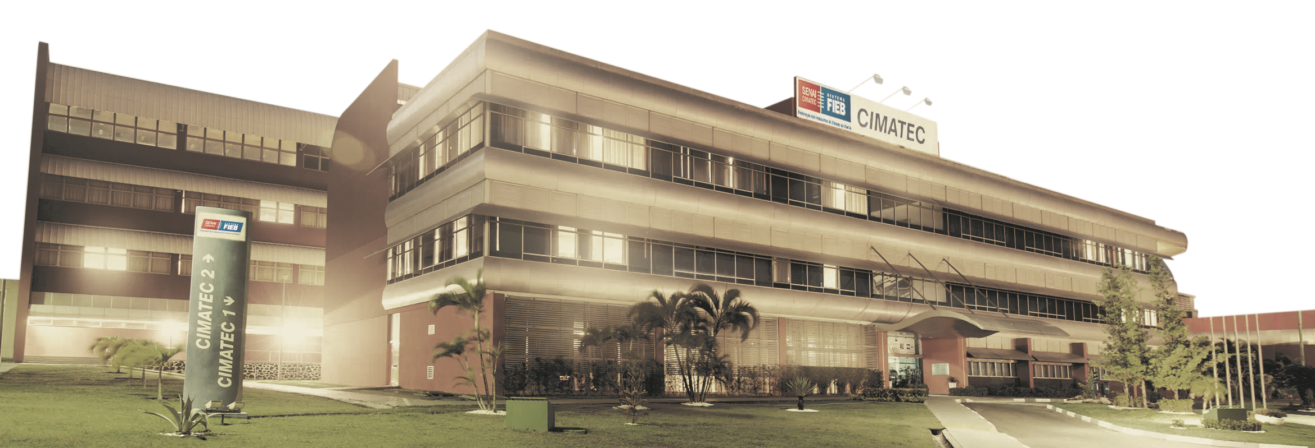
Model Factory
University
COVID
Accions
Faculdade SENAI CIMATEC
Masters
EMBRAPII
BIR
HPC 1
Yemoja
ITS
ISI SAS
2002
2007
2010
2012
2014
2016
2019
2020
2021 2023
2004
2008
2011
2013
2015
2017
Incubator
CIMATEC 3 & 4
2º PhD
Opening
CIMATEC 1
Opening
CIMATEC 2
1º PhD
CIMATEC
Park
Expansion CIMATEC
Park
100ª Master’s
Thesis
4 ISI
HPC 2
Omolu
6 IST
CIMATEC Timeline
1ª PhD Thesis
Notes:
Brazilian Institute of Robotics – BIR

Slide 7









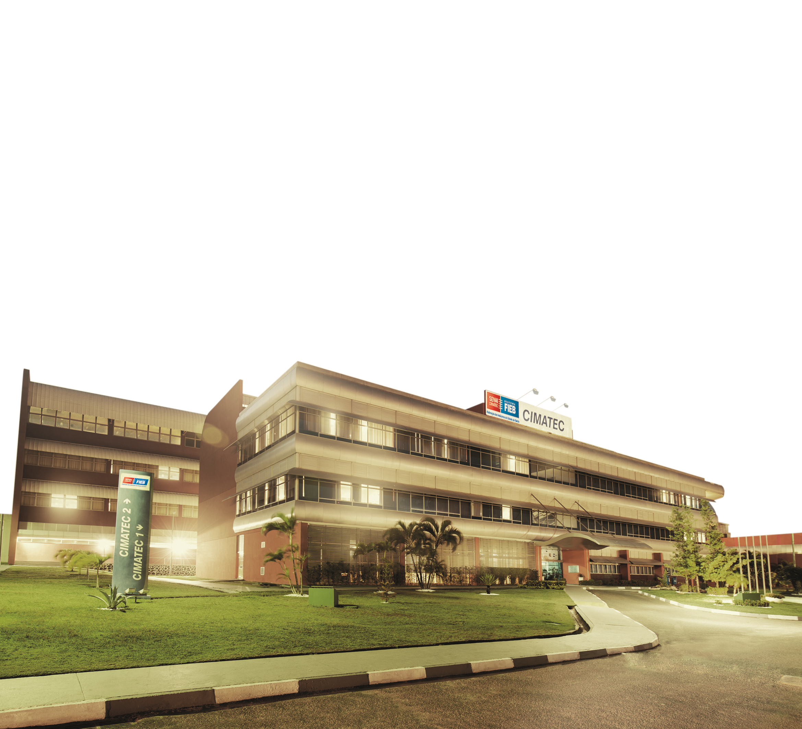
Ecosystem CIMATEC
Entrepreneurship and Innovation
EMBRAPII
Partners
Industrial
Technology
Centers
Areas of Competence
ISIs and ISTs

Slide 8


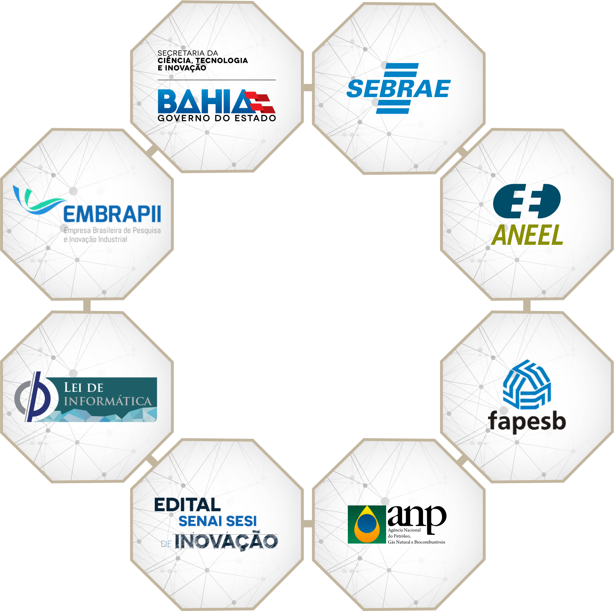
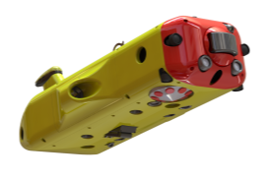




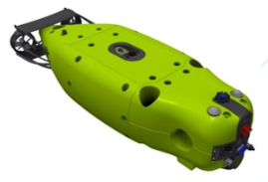

RI&D - Operating Model
Institutions
Partners
RI&D
Companies

Slide 9

CIMATEC – Collaboration in the World
.TEC
.EDU
.ORG
.COM
International cooperation for technology development
International academic cooperation
Government cooperation abroad
Support for Brazilian industry abroad

Slide 10
HPC
Code Portability and Optimization

Slide 11






Methodology
1
2
3
GEOPHYSICS
MODELING
MATHEMATICS
MODELING
COMPUTATIONAL
MODELING
1
2
3
4
5
APPLICATION PERFORMANCE ANALYSIS
DOMAIN SPLITTING STRATEGIES
PARALLEL AND DISTRIBUTED SOLUTION DESIGN
PERFORMANCE METRICS
RESULTS
ANALYSIS

Slide 12

STRUCTURE
APPLICATION
ANALYSIS
Mapping of Computational
Costs
Variables such as Latency, Granularity, Response Time, ... are evaluated
TIME HPC
CIMATEC
PORTABILITY
PARALLELISM
Adaptation to New Computing Architectures
Code Portability Optimization Specialists
Implementation of Computational Models
PERFORMANCE RESULTS
OPTIMIZATION
Decomposition, Distribution and Task Assignment Processes
Monitoring the methodology based on the results obtained

Slide 13



OPTIMIZATION TEAM
PhDs
Masters
PETERSON NOGUEIRA
PhD in
Geophysics
MURILO BORATTO
Doutor em
Computação
LEONARDO FIALHO
Doutor em
Computação
MARCELO OLIVEIRA
Doutor em
Computação
OSCAR MOJICA
PhD in
Geophysics
Experts
ÁTILA SARAIVA
Master in
Geophysics
LAIAN MOURA
Master in
Geophysics
VICTOR KOHENE
Master in
Geophysics
RODRIGO SANTANA
Master in
Geophysics
TIAGO CONCEIÇÃO
Master in
Computing Science
JOÃO SPEGLICH
Engineer
Computing
GUSTAVO COELHO
Engineer
Computing
GABRIEL PINHEIRO
Engineer
Computing
FILIPE MILANI
Engineer
Computing
MATHEU SANTOS
Engineer
Computing

Slide 14















CIMATEC – Collaboration in the World
ENGLAND
NETHERLANDS
FRANCE
ENGLAND
NORWAY
PORTUGAL
SPAIN
.EDU
CHILE
URUGUAY
USA

Slide 15










CIMATEC – Collaboration in the World
GERMANY
PORTUGAL
NETHERLANDS
SPAIN
.TEC
CHILE
URUGUAY
USA

Slide 16
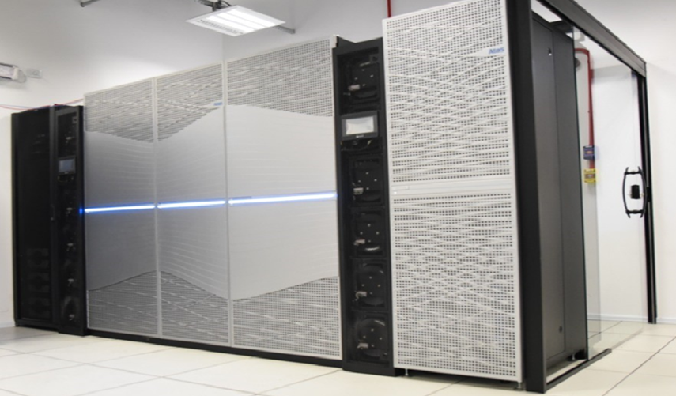
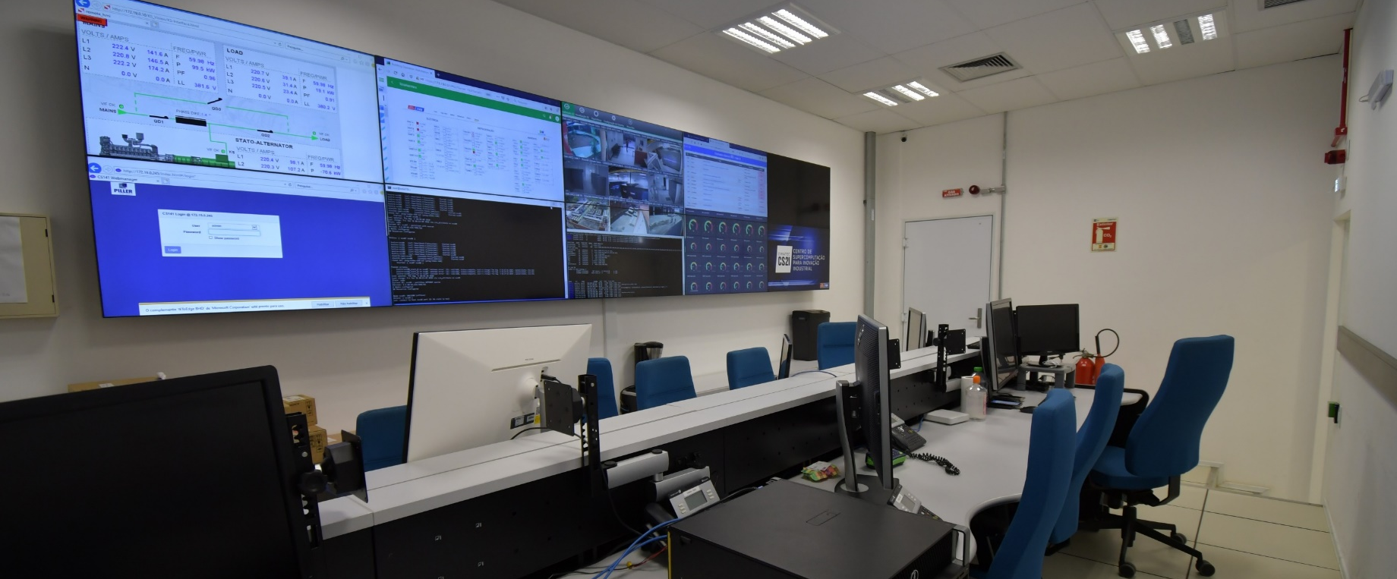



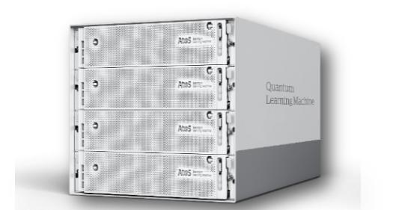
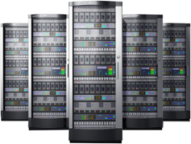
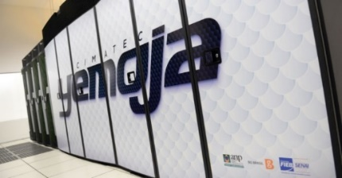
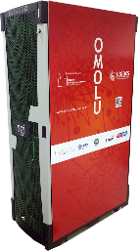
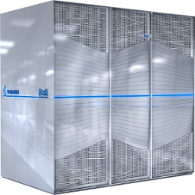
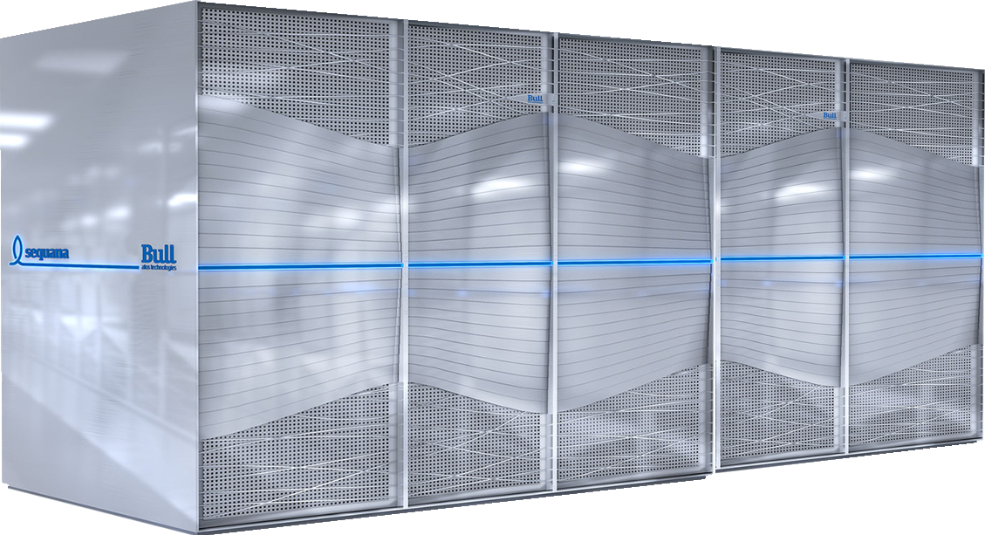



Brazilian Research and Development Institute
SENAI CIMATEC Supercomputing Center

Slide 17
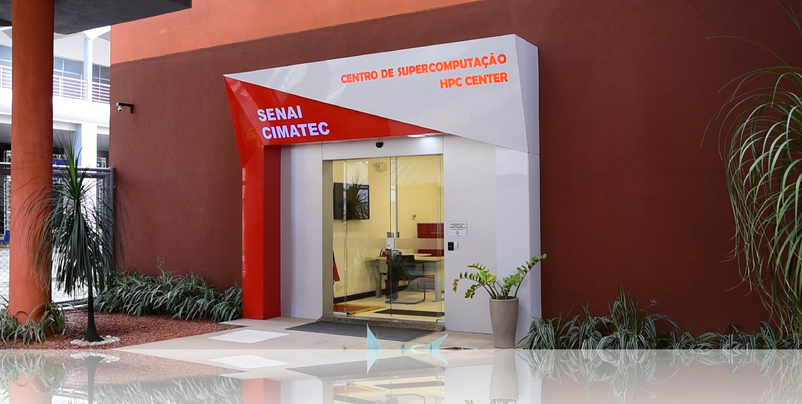
SENAI CIMATEC Supercomputing Center

Slide 18
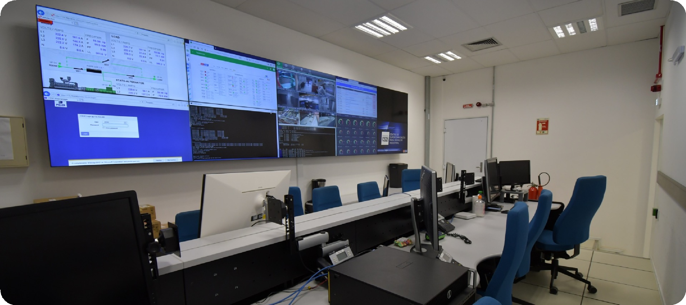
SENAI CIMATEC Supercomputing Center

Slide 19


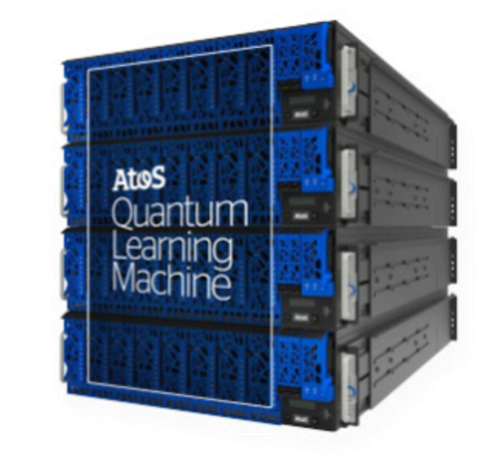


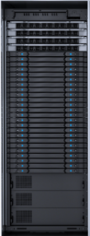
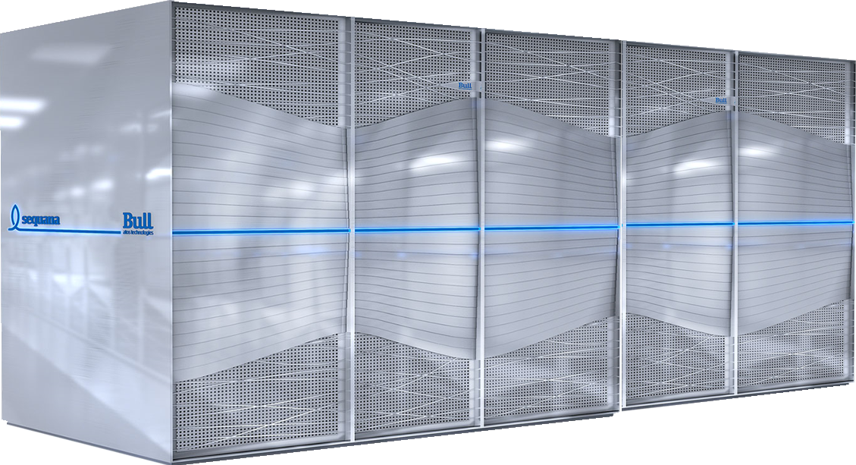



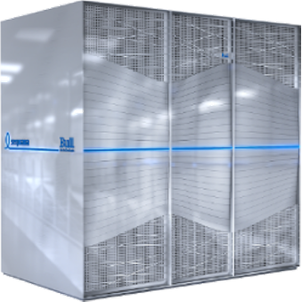




































Supercomputing Center Timeline
PhDs
Researchers
Masters
7. HPC CIMATEC
Park
5. HPC Oil & Gas (GPU)
6. Quantum Computing
Specialists
4. HPC Oil & Gas (CPU)
1.8 PetaFlops
312 V100
3. HPC FINEP
800 TeraFlops
2. Fiocruz OMOLU
180 TFlops
Researches Lines
Services
50 TFlops
1. Yemoja - Oil & Gás
Projects
Innovation
0. Cloud (Datacenter)
405 TeraFlops
Models
............................................
2024
2012
2015
2016
2018
2019
2020

Slide 20










HIGH PERFORMANCE COMPUTING
SENAI CIMATEC - CENPES PETROBRAS

Slide 21














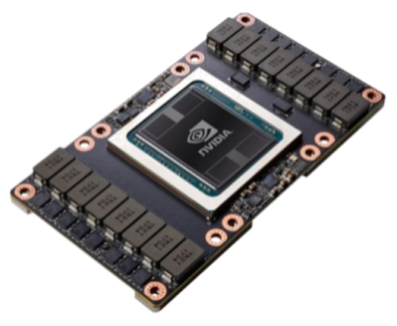
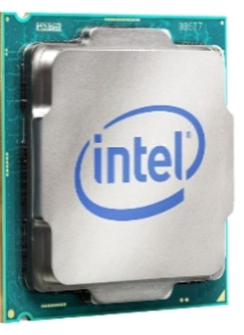
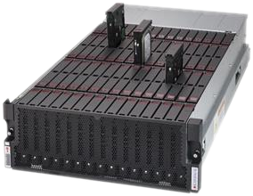



OGBON Supercomputer Specification
#347
100% Cool Water Technology Direct Cooling at 5 Racks
312 GPUs
78 Nodes
4 x NVIDIA V100 32 GB
1605 Peta Flops (RMAX) 384 GB RAM per node
210 CPUs
204 Tera Flops (RMAX)
2 x Intel Cascade Lake 384 GB RAM
1 PB Parallel Lustre 26 GB/s IOR
500 TB Storage
100 Gbps Infinband
8 Login Nodes

Slide 22

Code Optimization Projects CIMATEC
SENAI CIMATEC carries out research and development of complex projects, integrating them into customers' production systems.
Background photo created by kjpargeter - www.freepik.com

Slide 23

Timeline HPC
ENGINEERING
RESERVOIRS
RTM-FWI
FPGA
MARCHENKO
YEMOJA
HPC
RTM
ONEAPI
SPEED
PSO-FWI
TECNORED
DEVITO
CEREBRAS
2014
2016
2017
2018
2019
2021
2023

Slide 24
PROJECT
YEMOJA
HPC
GOAL
The first project of the SENAI CIMATEC supercomputing center aimed to process images of the Brazilian pre-salt oil reserve layer. And only through the processing of seismic imaging of this layer was it possible to measure the values of barrels of oil produced.
Notes:
SAIPEM

Slide 25
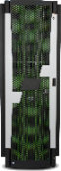
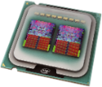
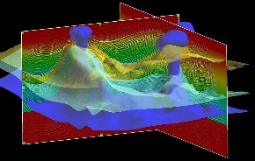

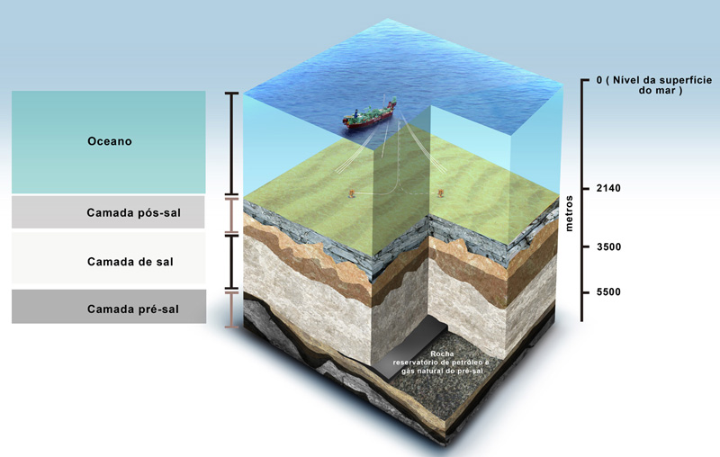
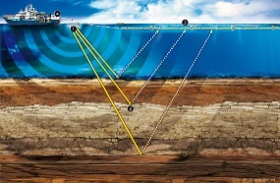
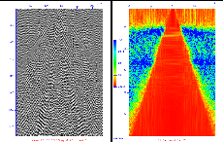
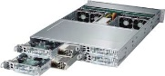
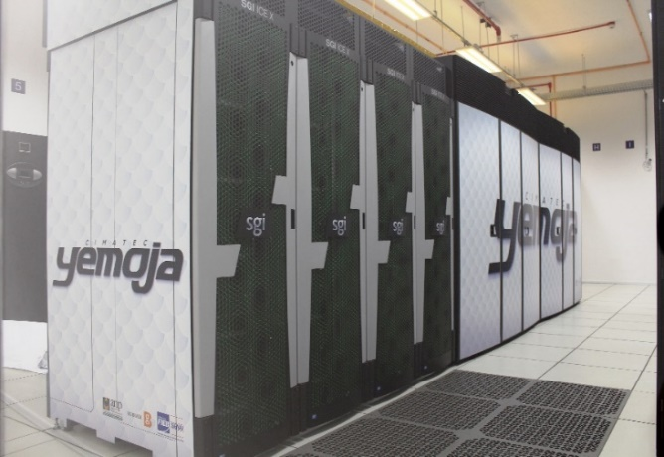
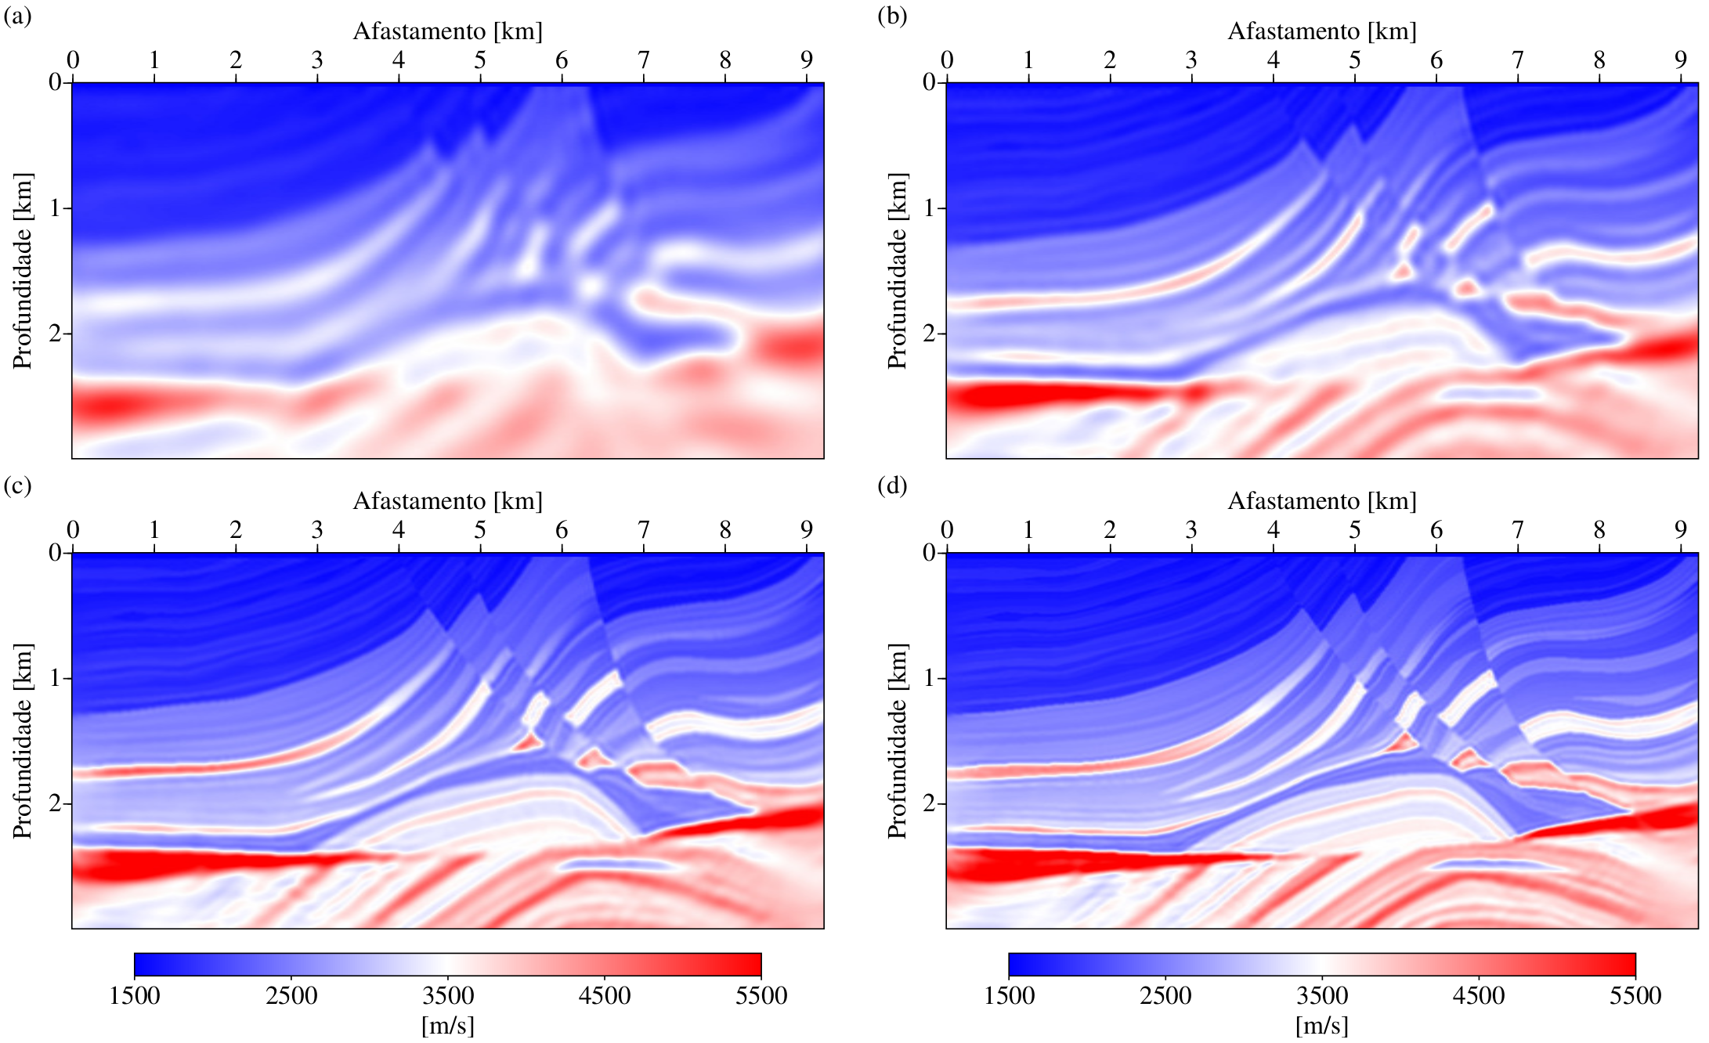
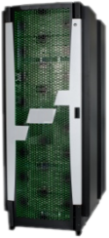

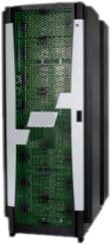

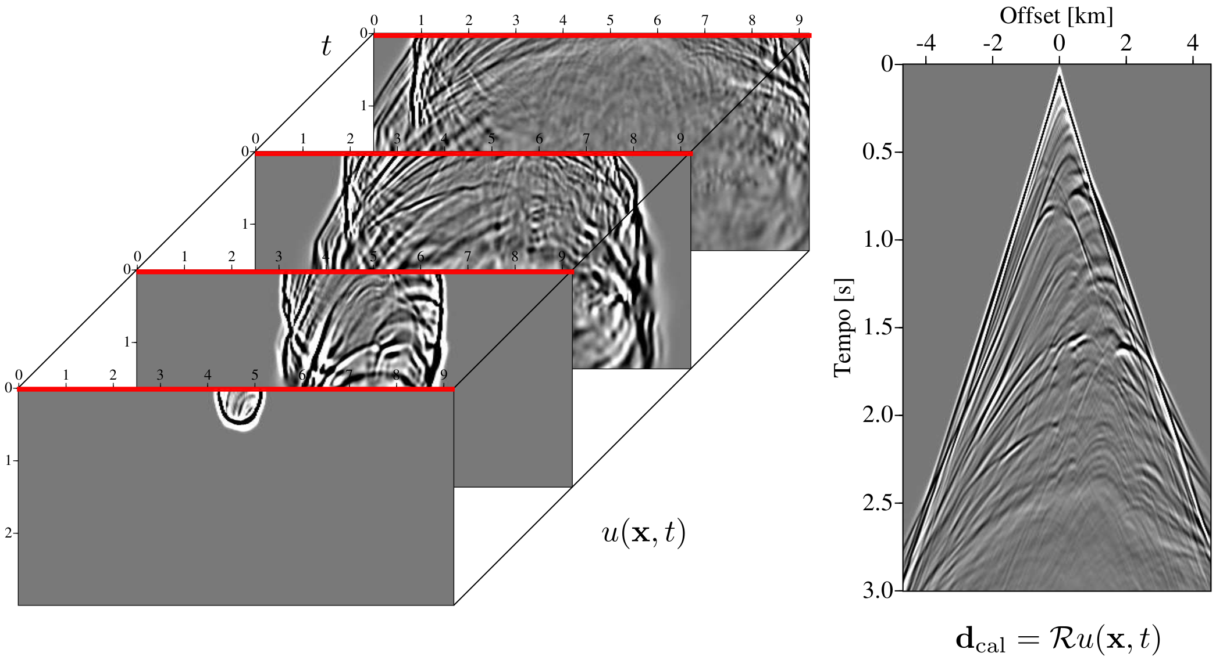
PROJECT
YEMOJA HPC
Acquisition
Pre-Processing
Processing
Interpretation
Raw Data
Filtering
Regularization
Edition
Parallelization
Optimization
Execution
Seismic Image
Pre-Salt
Seismic Pre-Salt Challenges:
High Impedance Contrasts
High P-wave velocity in salt layer
Complex Propagation Trajectories
Internal Multiples
Complex structural configurations
Low Amplitudes in pre-salt layer
Two new machines
FINEP - Industrial
Fiocruz - BigData for Health

Slide 26
PROJECT
TecnoRed-CFD
GOAL
This project aimed to study and experiment with heterogeneous computing techniques in supercomputing environments, which intended to describe the processes for parallel optimization of the TECNORED-CFD software using GPUs.
Notes:
SAIPEM

Slide 27











PROJECT
TecnoRed-CFD
CO₂
Emission
2 ton / ton steel
CONVENTIONAL REDUCTION PROCESS
Implementation and operation cost
Iron
specifications
Sintering Plant
Process duration
8h
Inputs
Expensive and complex
Coke
Blast furnace
Performance

Slide 28
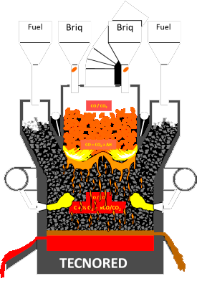



PROJECT
TecnoRed-CFD
Industrial Waste
Iron ore
Briquetting
Operation Center
Cheap Coal
Reduction and Merger
Processing of Fuel and Self-Reducing Briquettes

Slide 29
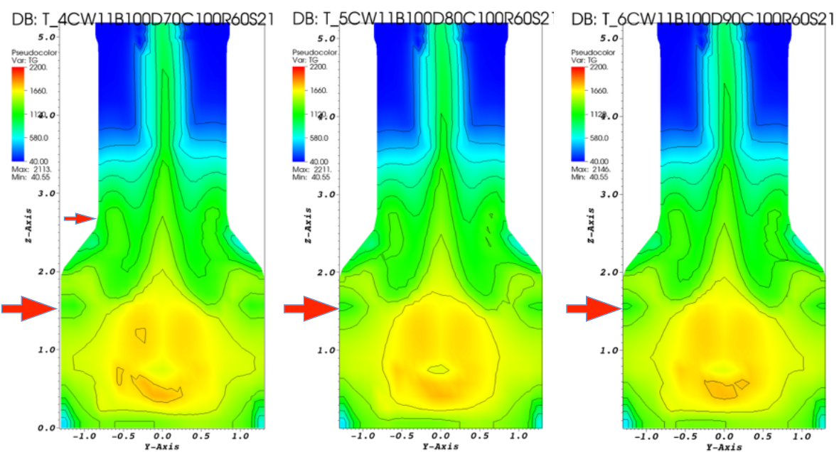
PROJECT
TecnoRed-CFD
Execução Projeto de Pesquisa
Outcomes
Etapas
Informational
Conceptual
Performance analysis
M 1
M 2
Parallelization
Experimental Tests C1
MD Software Simulation V0
Validation/ Performance Tests/ Parameter Simulation
M 3
Research project
HPC
Computational Fluid Dynamics
Process

Slide 30
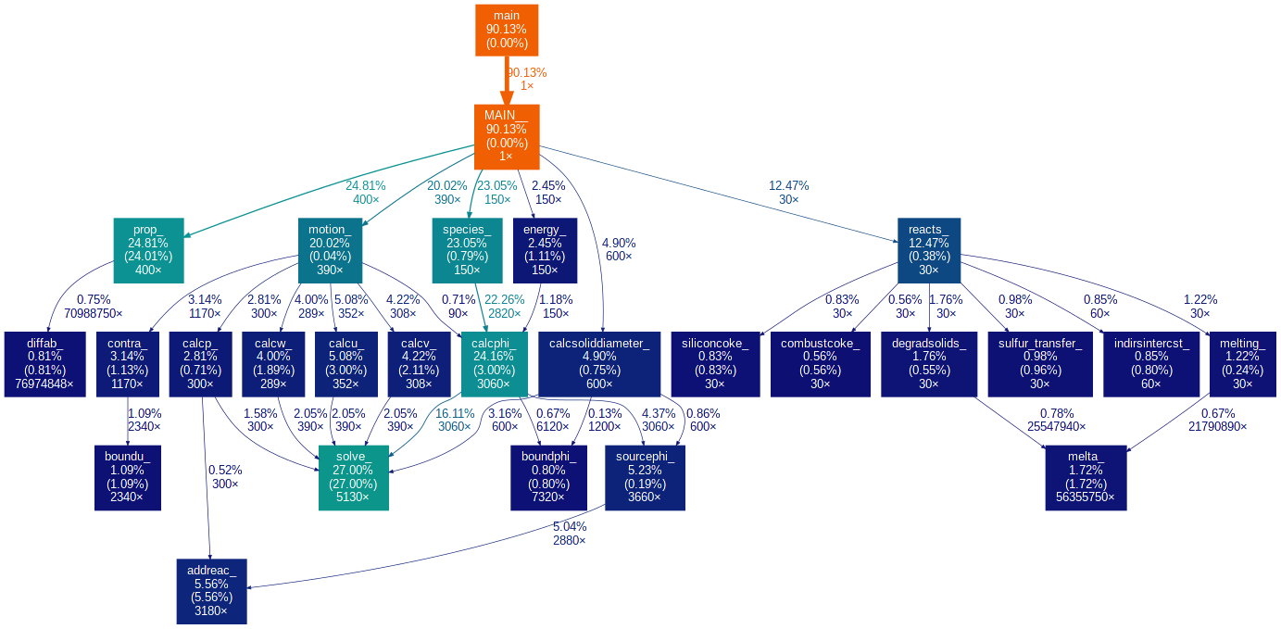
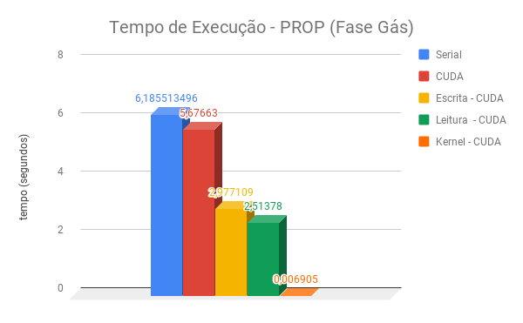
PROJECT
TecnoRed-CFD
Notes:
Cross compilation C/C++/FORTRAN

Slide 31
PROJECT
Engineering of
Reservoirs
GOAL
This project aimed to develop and improve the computational codes developed by CENPES for use in the area of reservoir engineering.
Notes:
SAIPEM

Slide 32
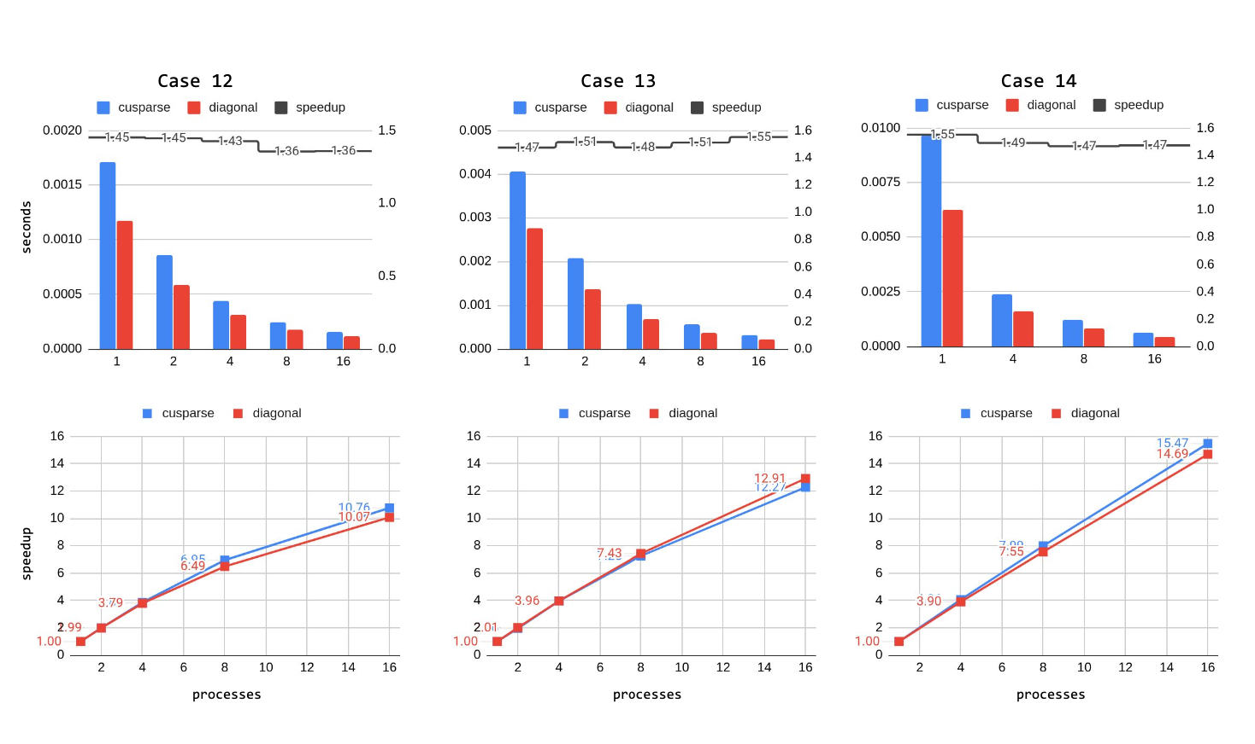
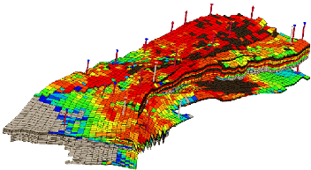
PROJECT
Reservoir Engineering
Code Optimization and Portability:
Adaptation to new Architectures
SOLVERBR
Performance Analysis
PETSc
Performance Metrics
SPEEDUP

Slide 33
PROJECT
SPEED
GOAL
Development and validation of the prototype of a scalable and specific computational model for execution on supercomputers for the generation of seismic images with 3D data.
Notes:
SAIPEM

Slide 34
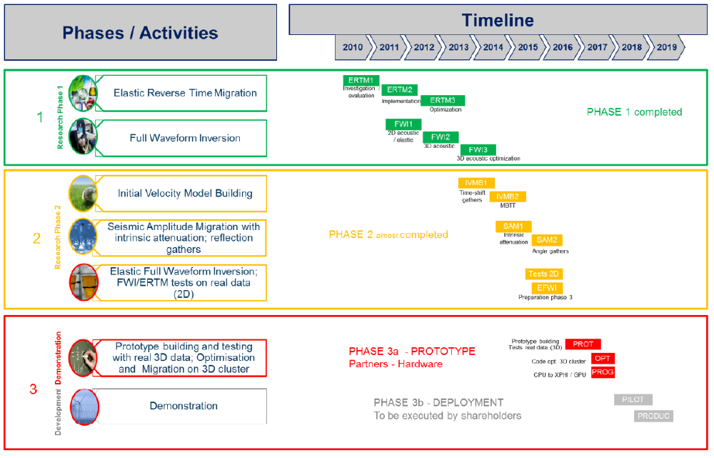
PROJECT
RSB SPEED: Computational Model intended for
3D Seismic Imaging for execution on Supercomputers

Slide 35
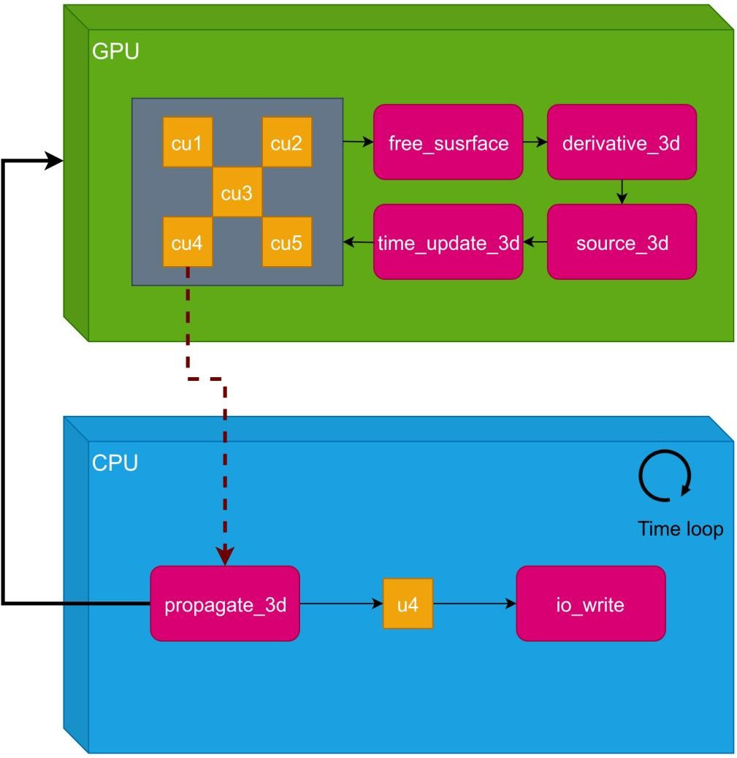
PROJECT
RSB SPEED: Computational Model intended for
3D Seismic Imaging for execution on Supercomputers
RESULTS OF RESEARCH AND CODE DEVELOPMENT (OUTCOME 5)​
Speed GPU VERSION 2
The implementation of other kernels made it possible for the temporal loop to be done within the GPU;
Development of methods to improve the relationship between host-device communication for data transfer and model computation time;
The u[1-5] structures are now inside the GPU.

Slide 36
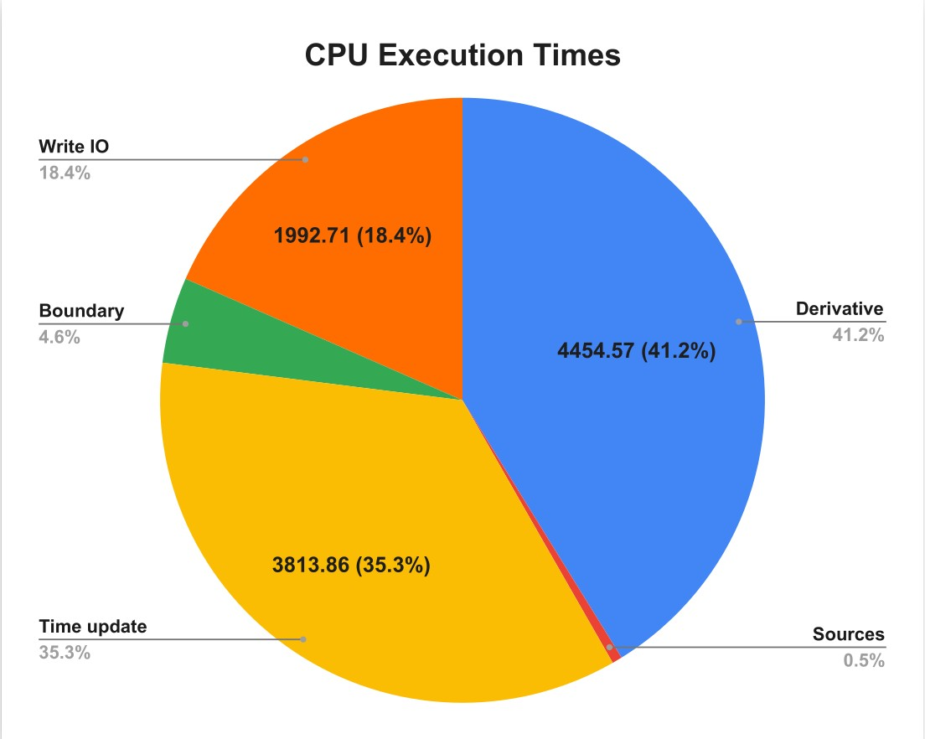
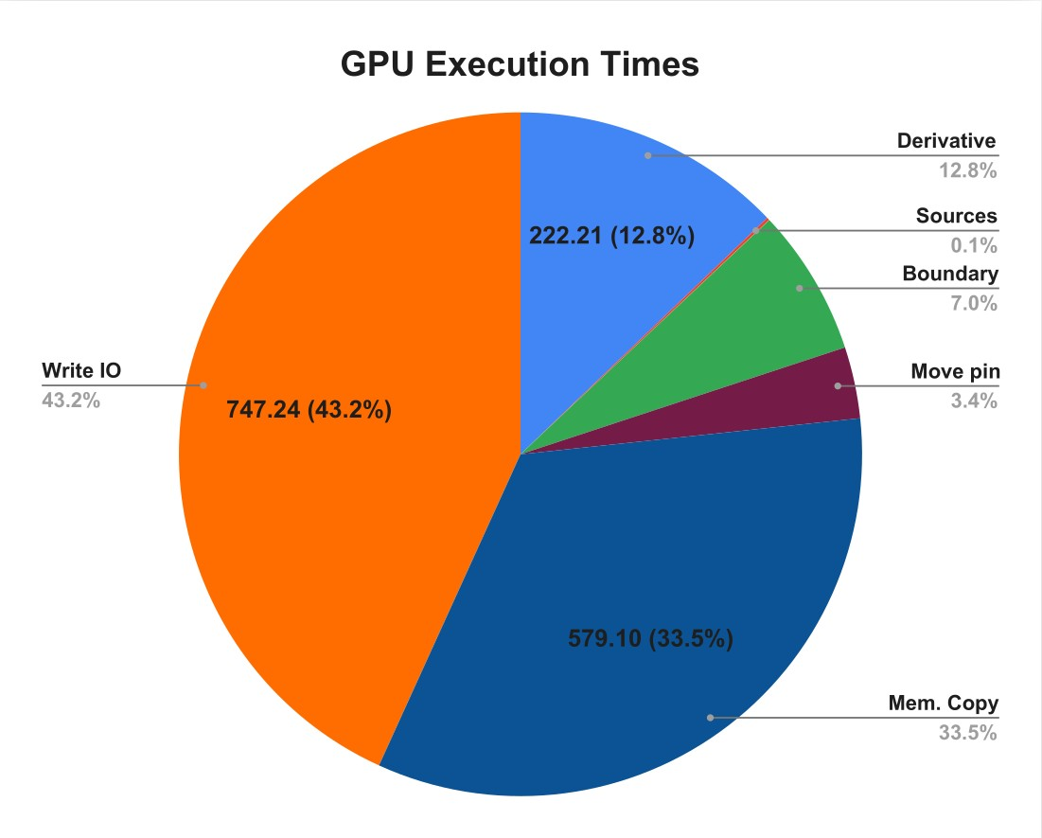
PROJECT
RSB SPEED: Computational Model intended for
3D Seismic Imaging for execution on Supercomputers
RESULTS OF RESEARCH AND CODE DEVELOPMENT (OUTCOME 6)​

Slide 37
PROJECT
RSB SPEED: Computational Model intended for
3D Seismic Imaging for execution on Supercomputers
RESULTS OF RESEARCH AND CODE DEVELOPMENT (OUTCOME 6)​
 | Average Model CPU | Average Model GPU | Real Model CPU | Real Model GPU
Propagation | 1060.26 | 105.00 | 10807.07 | 1302.51
Speedup | 10X |  | 8X
Image | 212.51 | 153.04 | 2424.19 | 2058.86
Total (S) | 1272.77 | 258.04 | 13231.26 | 3361.37

Slide 38
PROJECT
RTM-FWI
FPGA
GOAL
This project aimed to perform a comparative analysis of accelerators based on RTM/FWI hardware implemented in FPGA and GPGPU.
Notes:
SAIPEM

Slide 39






PROJECT
RTM-FWI FPGA
FPGA to accelerate RTM, FWI and Seismic Imaging Algorithms
Operation
System (OS)
HPC Scalable Processing
Clusters
Motherboard (Node)
FPGA
Seismic Co-Processor
PCI-Express

Slide 40
PROJECT
Marchenko
GOAL
This project aims to research, validate and apply the Marchenko iterative scheme in the attenuation of multiple reflections and in the construction of 2D/3D seismic images on real seismic data in a high-performance computing environment.
Notes:
SAIPEM

Slide 41

PROJECT
Marchenko Imaging
What is the Marchenko Method?
Marchenko's iterative scheme allows calculating Green's up and down functions using as input data
the complete acquisition at the earth's surface and a smoothed velocity field to calculate the initial focusing functions.
Equation (Thorbecke, et al, 2017):
Project Marchenko
Marchenko imaging on real 2D/3D data
2D/3D multiple attenuation and removal

Slide 42





PROJECT
Marchenko Imaging
Consiste em modelar a função de focalização inicial ($N_{0}$) com diferenças finitas ou a equação Eikonal e iniciar o processo de cálculo
dos seguintes fatores:
Imageamento
Paso 0
Paso 1
/2
/2
Kernel
cross-correlação
Paso 2

Slide 43





PROJECT
Marchenko Imaging
Pipelines on GPU
Step 1
Step 0
Step 2
Image

Slide 44



PROJECT
Marchenko Imaging
Data distributions on the GPU : Thorbecke, et al. 2017 vs Ravasi, et al. 2020
Thorbecke
Ravasi
Node Specifications
CPU
2 Intel (R) Xeon (R) Gold 6240 CPU
@ 2.60 GHz with 18 cores each node;
376GB.
GPU
4 TESLA V100 com 32GB de memória global cada nó.
Numeric example specifications
3-layer flat model
Refl (shots): 201*61=1261 shots/receptors, 286 frequencies, total 170GB;
f0s (initial focusing functions): 201*61 receivers, increase step 50. Each 100 points have 1,5 GB.

Slide 45
PROJECT
PSO-FWI
GOAL
This project aimed to obtain estimates of 2D acoustic macromodels using PSO-FWI (Particle Swarm Optimization - Full-Waveform Inversion).
Notes:
SAIPEM

Slide 46




PROJECT
PSO-FWI
Model of properties Vp
Forward problem
Modeling
Inversion
Seismic data
Inverse problem
Goal: Improvement of the velocity field >>>>> improve the quality of the seismic image in depth
PSO
FWI
Higher resolution

Slide 47
PROJECT
RTM
OneAPI
GOAL
Explore the functionalities of the Intel OneAPI API and the capabilities of the DPC++ compiler to deal with heterogeneous computing in a multi-GPU system using as a proof of concept a seismic imaging application for a two-dimensional acoustic case of the Reverse Time Migration (RTM) algorithm.
Notes:
SAIPEM

Slide 48





PROJECT
RTM Domain Division on Multi-GPU using OneAPI
[Multi-GPU 2D-RTM] Migration and propagation structure of an acoustic model using multiple GPUs.

Slide 49


PROJECT
RTM Domain Division on Multi-GPU using OneAPI
Comparison of results in C and SYCL/DPC++ after reengineering

Slide 50
Murilo Boratto
murilo.boratto@fieb.org.br

